Slide 1
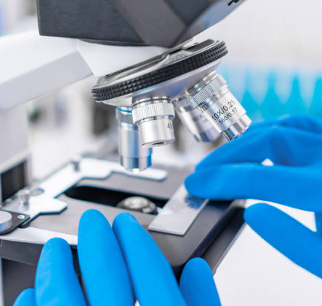
Cancer Histopathology Image Classification
Dhani Pozniak

Slide 2
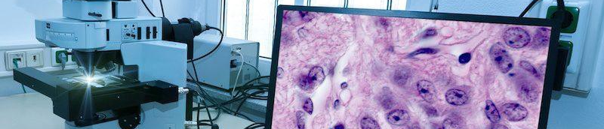
Business Understanding
Investigation of cells and tissues at a microscopic level
Digital histopathology has evolved significantly in modern medicine
Visualize the status of biological structure which can be used to diagnose diseases like cancer
Specialized cameras with a microscope
Notes:
These medical experts are responsible for determining appropriate actions/ treatments for patients, depending on the nature and severity of the disease.

Slide 3
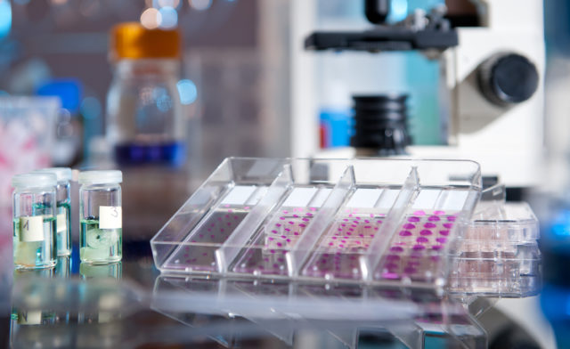
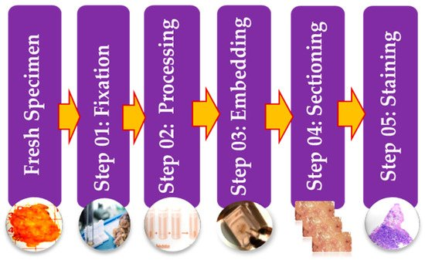
Histopathological Image Preparation
Diagnosticians compare new processed images with those of healthy tissue samples in order to identify any differences or abnormalities
Staining the tissue with dyes increases the contrast to the tissue sample and highlights specific features
Notes:
. The specimen is embedded in wax and stained with dyes to separate cellular components so that the architecture and constituent of the sample can be studied for diagnosis.
After the image has been processed, the diagnostician compares the image with those of healthy tissue samples in order to identify and differences or abnormalities. The preparation process aids the diagnostician in analysis and classification of the tissue sample.
Similarly with machine algorithms, after they have been trained, will take the new image and compare it with the patterns and features it has learned during its training phase which will enable it to accurately match the image with the respective class.

Slide 4
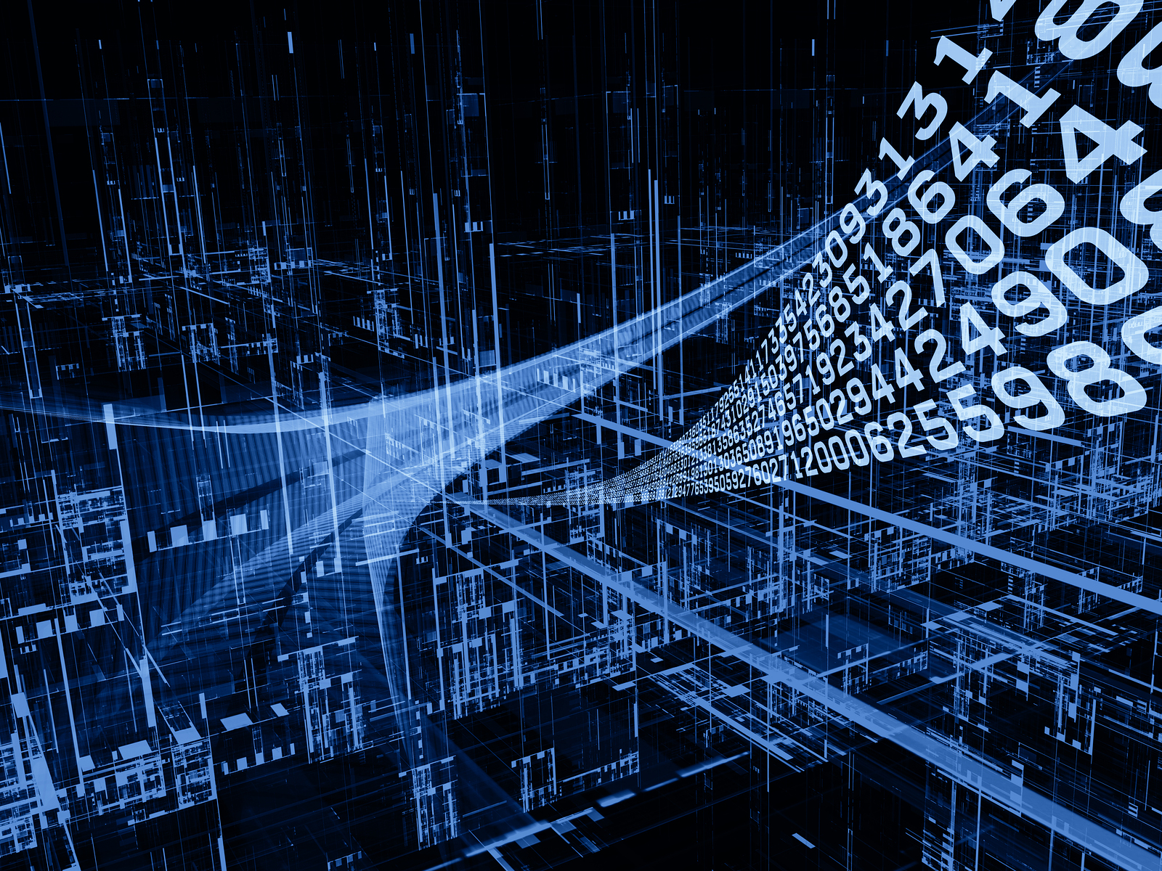
Machine Learning in Histopathology
ML models preserve performance while decreasing the workload for pathologists
Essential for CAD models to precisely and confidently label classes and minimize reading interpretation run times
The processes for a CAD model in large patient populations would include receiving a batch of raw images, pre-processing them, and then produce an array of diagnosis labels.
Increased storage/ cloud capabilities has made it easier to store large numbers of digitized images enabling fast remote analysis and secure pathology information.
ML models will offload some of the pressure for Doctors and diagnosticians by reducing redundancy and improving accuracy and capacity.
Notes:
Areas where CAD models can be applied in the histopathological industry include:
Cancer detection in the supplied tissue.
Disease characterization through automatic grading that quantifies the malignancy level.
Discovery and separation of cell/ nuclei/ gland regions from images by segmentation.
Multi-class classification of various subtypes of a specific cancer.

Slide 5
Data Understanding
A. Borkowski, "Lung and Colon Cancer Histopathological Images", Kaggle.com, 2020. [Online]. Available: https://www.kaggle.com/datasets/andrewmvd/lung-and-colon-cancer-histopathological-images. [Accessed: 30- Jul- 2022].
Borkowski AA, Bui MM, Thomas LB, Wilson CP, DeLand LA, Mastorides SM. Lung and Colon Cancer Histopathological Image Dataset (LC25000). arXiv:1912.12142v1 [eess.IV], 2019
25000 images, 5 Classes
Image Labels:
Lung benign tissue: 3
Lung adenocarcinoma: 2
Lung squamous cell carcinoma: 4
Colon adenocarcinoma: 0
Colon benign tissue: 1

Slide 6
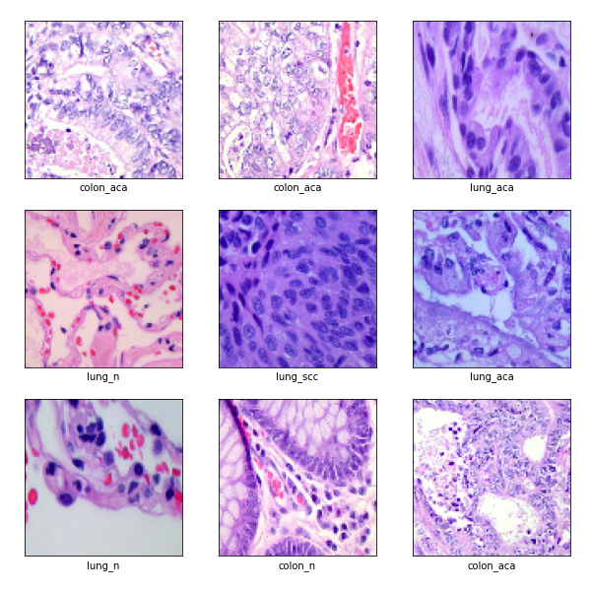
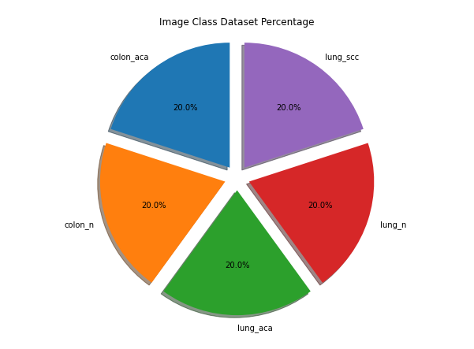
Data Preparation
Initial analysis shows a balanced dataset and successful loading of images
Images resized from 768x768 to 96x96 which will be beneficial with storage capacity
Notes:
Large sizes in digitized images create a challenge when it comes to storage capacity, pre-processing the data so that it is compatible with deep learning algorithms. A common method to deal with this issue is normalizing the image. This results in a trade-off where data is lost which affects the performance of the ML model.
Data augmentation and image data generator are tools used to apply transformations to the image which multiplies the dataset if dealing with limited amounts of data available.

Slide 7
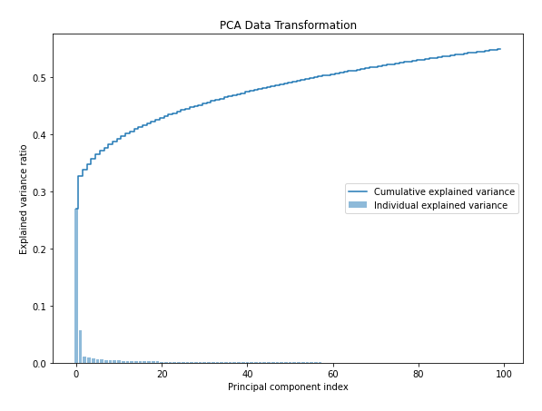
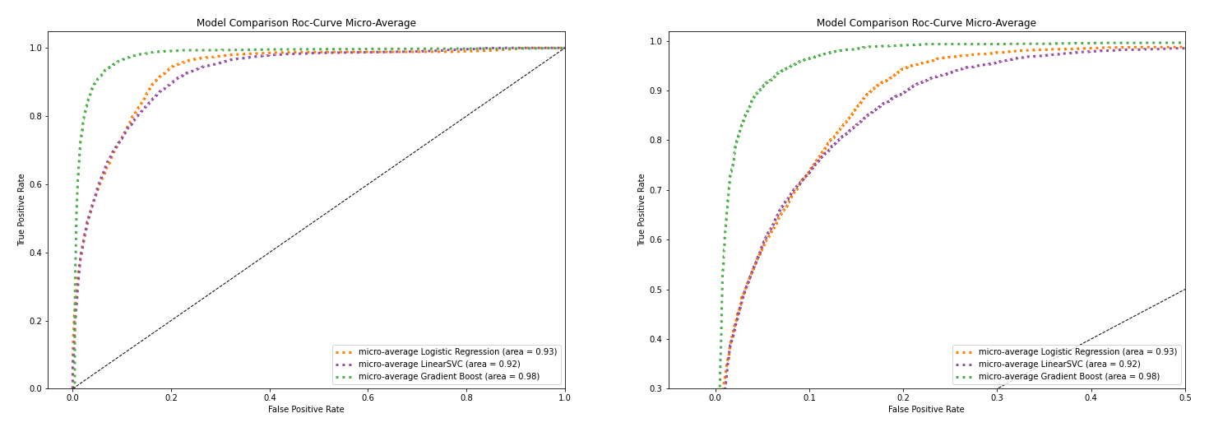
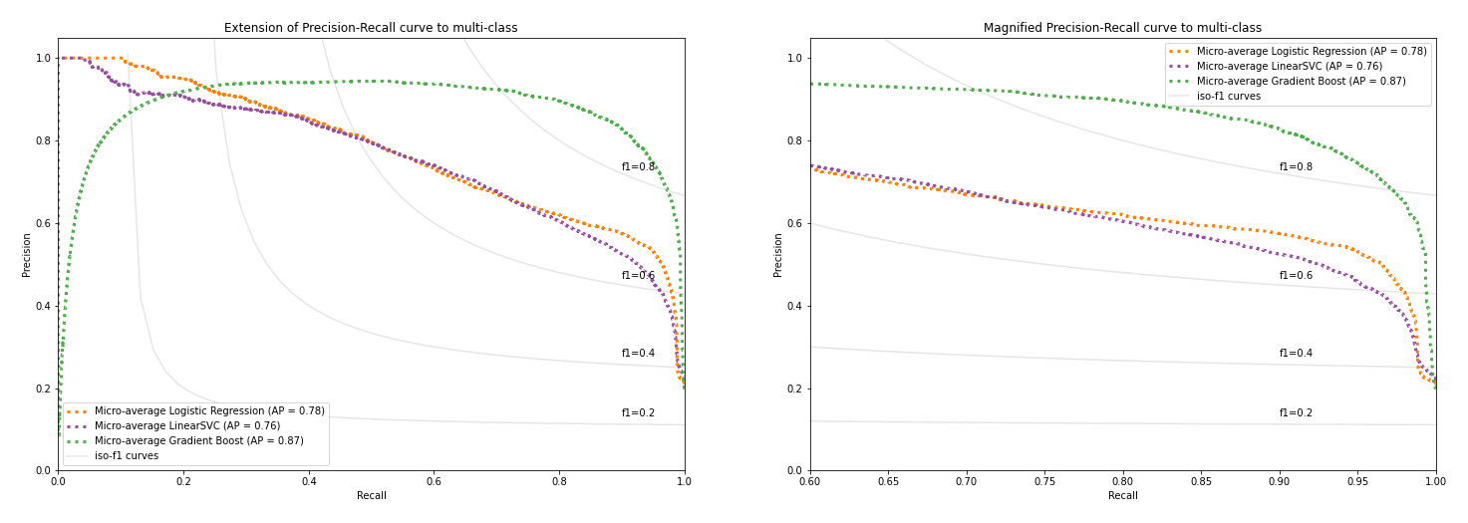
Feature Engineering
PCA reduce features from 27649 to 100
Represented 55% of the spread of data
Gradient Boosting able to achieve 88% accuracy score

Slide 8
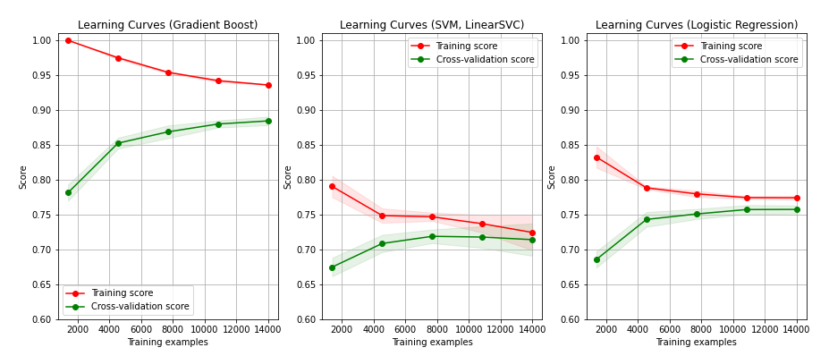
Learning Curves (GradBst, SVC, LogReg)
Performed well considering half the data lost, be careful of overfitting
Convolutional Neural Networks preferred algorithm
Notes:
Considering half the data was lost in the transformation models performed well but this was necessary to prevent overfitting when fitting the transformed dataset to machine learning algorithms such as Logistic Regression.

Slide 9
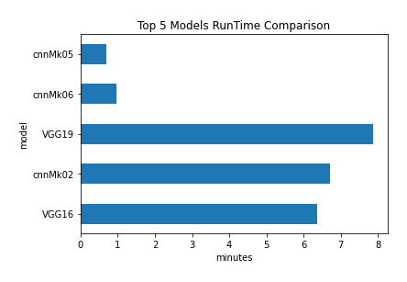
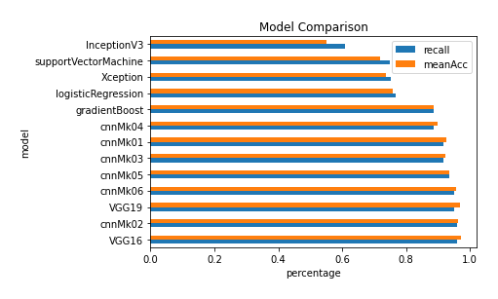
Model Comparison
Focus on Recall (false negatives)
Proportion of actual positives identified correctly
BatchNormalization/ Dropout/ MaxPooling/ Dense Layers
Runtime for 7500 unseen images processed and classified

Slide 10
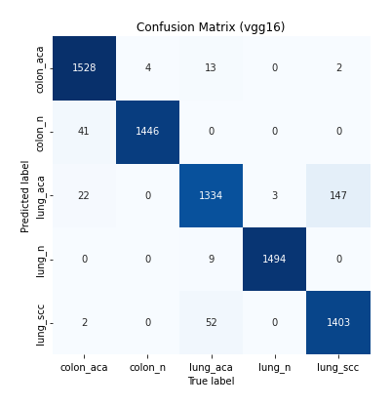
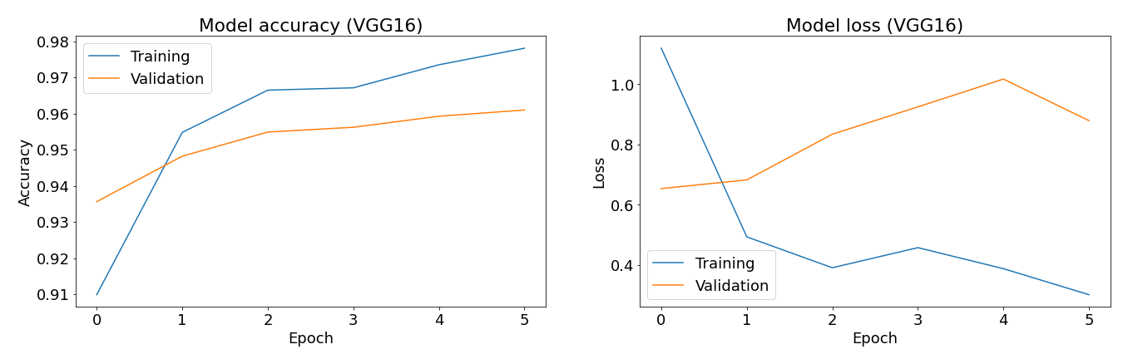
Pre-Trained CNN (VGG16)
Total Params: 14 737 733
21 Hidden Layers
10 epochs
Classified 7500 unseen images in 6 minutes with 96% accuracy

Slide 11

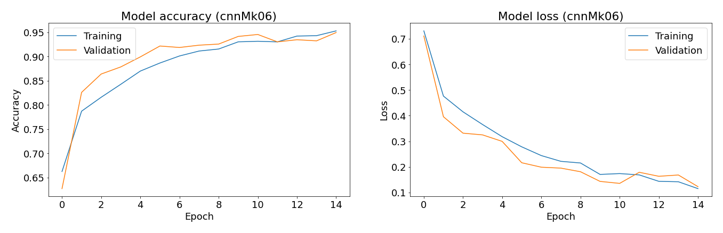
Custom CNN (cnnMk06)
Total Params: 66 565
8 Hidden Layers
15 epochs
Classified 7500 unseen images in 1 minute with 95% accuracy

Slide 12
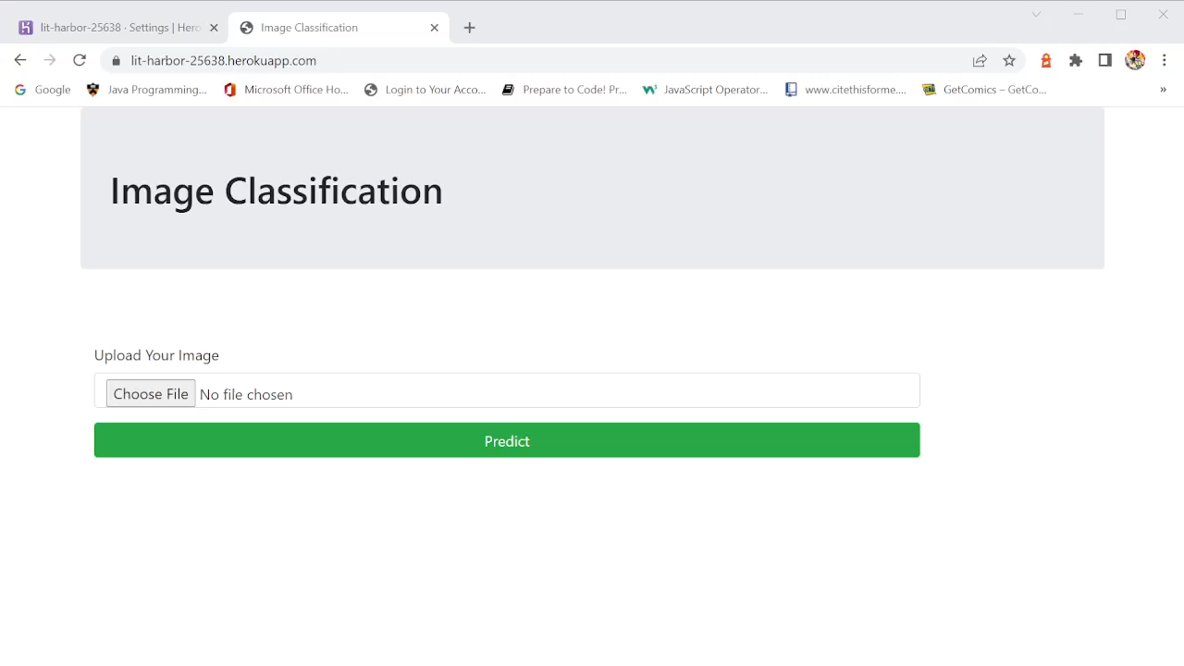
Deployment Demo: https://lit-harbor-25638.herokuapp.com/
Notes:
At this juncture, the results of the deep learning algorithms indicate a promising future for image classification models becoming successfully integrated into the medical industry.
This does not mean that machines will replace humans.
Importance of yearly check-ups, might have healthy cells now but that might change in a year. There might not be enough presence of the cancer for the machine to classify accuratly, humans can make a similar mistakes. Not just a one time event were you have to get it right the first time, there are other factors involved
A balanced dataset has a positive effect on the performance of machine learning algorithms, if a business had a balanced implementation between machines and humans, this would have a positive effect on productivity, efficiency, and capacity.

Slide 13
Future Development
The cnnMk06 legitimate model is able to predict with 95% confidence the class of the histopathological image
Consider separate models for each cancer (colon/ lung)
With better processing equipment, extend the number of epochs run
Further finetuning of custom model
store large numbers of digitized images enabling fast remote analysis and secure pathology information (96x96) instead of (768x768)
preserve performance while decreasing the workload for pathologists so that they can focus on future research and development to enhance and evolve the medical industry
Notes:
The CNN model’s ability to process large amounts of data quickly will allow diagnosticians to focus on research and development into more advanced classification techniques.
Also, there is a lot that can be learned from the deep learning algorithms in the way that they are able to differentiate one image from another.
This will lead to other features and characteristics of cancerous cell structures that humans might have never considered.
Due to limited resources, the amount of epochs used for fitting the models was limited and the runtimes recorded might be different if the models were run on a machine with higher processing capabilities.

Slide 14
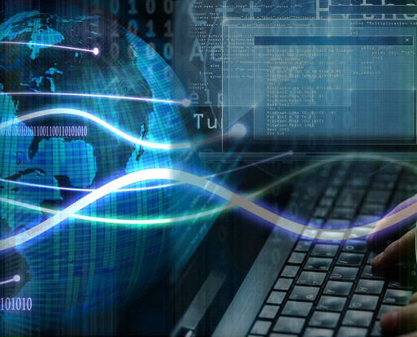
Contact
LinkedIn https://www.linkedin.com/in/dhani-pozniak-34801a196/
Email pozengineer@hotmail.com
Phone 0412 966 933
Github https://github.com/pozengineer/dataScienceImageClassify/

Slide 15

Thank You
Any Questions ?

